Slide 1


A presentation on minor project titled SwiftScribe PDF Platform SUBMITTED BY Name1: Prince Gupta Roll No:0213Cs211074 Name2:Ashima Singh Roll No:0213Cs211022 Name3:Sweta Ghoshi Roll No:0213Cs211120 SESSION 2023-2024
DEPARTMENT OF COMPUTER SCIENCE & ENGINEERING
SHRI RAM INSTITUTE OF SCIENCE & TECHNOLOGY, JABALPUR

Slide 2
CONTENTS
INTRODUCTION
PROBLEM STATEMENT
SCOPE
TOOLS DESCRIPTION
DESIGN (DIAGRAMS LIKE E-R MODEL, CLASS, DFD, SEQUENCE, USE CASE)
METHODOLOGY(ALGORITHMS)
OUTPUT SNAPSHOTS
TESTING MECHANISM
CONCLUSION

Slide 3

Introducing our PDF SaaS Platform
A revolutionary tool that enables users to engage in real-time conversations with their own uploaded PDF documents.
With our platform, users can seamlessly interact with their PDF files, fostering collaboration and enhancing productivity like never before.

Slide 4
Problem Statement:
Challenges:
Solution:
1. Manual PDF summarization consumes time.
2. Extracting data from PDFs is tedious.
3. Traditional methods lack efficiency.
The SaaS platform aims to address this by providing an automated solution for processing and summarizing PDF content. Users can upload PDFs, and the platform utilizes AI to extract key information and answer user questions about the document in real-time.
Businesses and individuals often struggle with efficiently managing and extracting information from PDF documents. Manually reading and summarizing PDFs can be time-consuming and tedious.

Slide 5

Scope: Define PDF SaaS's target users
PDF SaaS is designed to cater to a wide range of users, with a specific focus on students. The target audience includes:
Students who frequently need to work on their PDF documents for their assignments and projects
Teachers and educators who require a user-friendly and affordable PDF solution to enhance their teaching materials
PDF SaaS also offers a chat functionality, allowing users to easily communicate and collaborate on PDF documents.

Slide 6



Tools
Programming Languages
Database
Frameworks
The PDF SaaS platform is built using a combination of Next.js 13, React, Prisma, and tRPC to ensure cross-platform compatibility and scalability.
The platform utilizes a Planet Scale PostgreSQL database to store user data, document metadata, and processing history in a secure and scalable manner.
The development process leverages popular frameworks like Next.js 13, React, Prisma, and tRPC to ensure efficiency, modularity, and a consistent user experience.

Slide 7
Design Approach
System Architecture:
User Flow:
Frontend components (UI/UX)
User registration and login process
Backend infrastructure (server, database)
PDF upload and processing steps
Integration points (APIs, external services)
Chat interface interaction
Integration Points:
User Interface:
Highlight any external integrations or dependencies, such as:
Include screenshots or wireframes of key UI screens:
Third-party services for PDF processing or data extraction
PDF upload interface
APIs for chat functionality or authentication
Chat window

Slide 8



Methodology: Discuss algorithms
Data Extraction
1
Efficiently extract important information from PDF files
Content Analysis
2
Understand the structure and meaning of documents
Large Language Model (LLM)
3
Utilize a powerful language model to enhance document understanding and analysis
At the core of the PDF SaaS platform are advanced algorithms that power its key functionalities. These include efficient data extraction from PDF files, understanding the structure and meaning of documents, and utilizing a Large Language Model (LLM) to enhance document understanding and analysis.

Slide 9
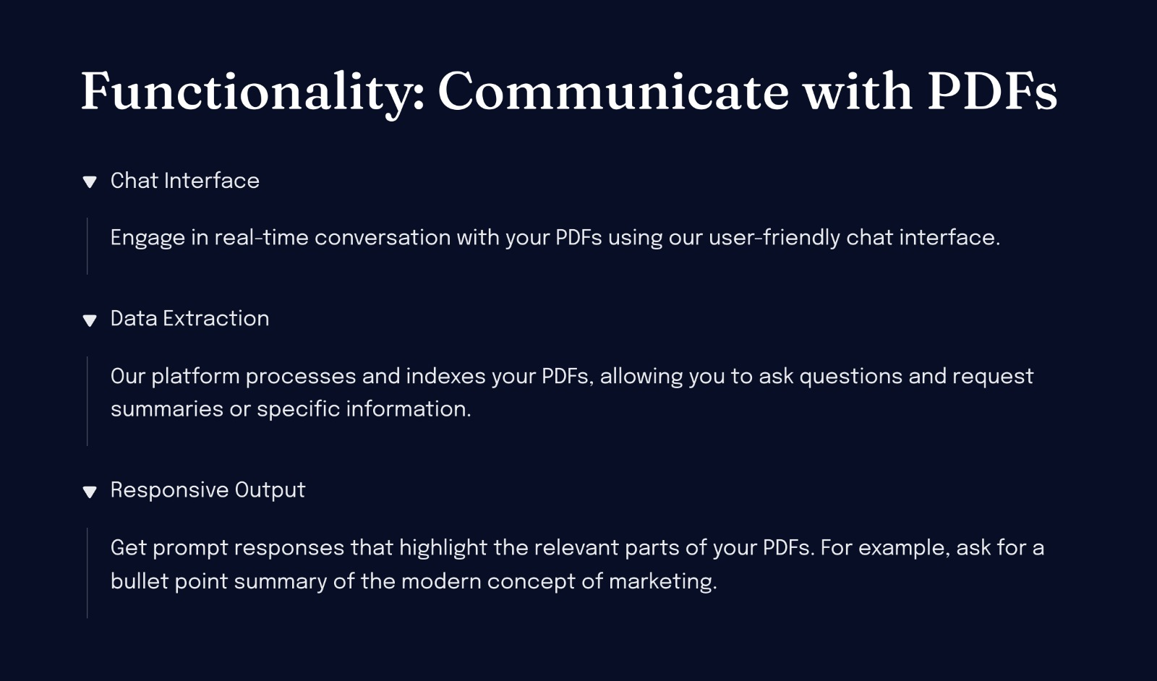

Slide 10
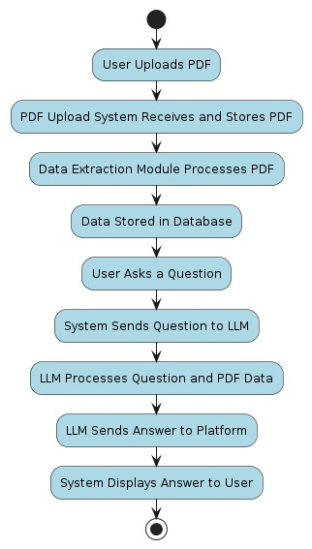
Design: Activity Diagram

Slide 11
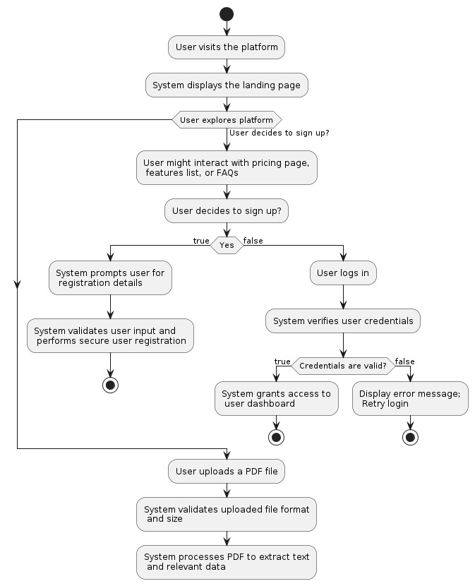
Design: Control Flow Diagram

Slide 12




Testing:
Unit Tests
Integration Tests
End-to-End Tests
Rigorously test individual components and modules to ensure they function as expected. Ex-jest and mocha.
Verify how different parts of the system work together, checking for any integration issues.
Simulate real-world user scenarios to validate the entire application flow from start to finish.

Slide 13
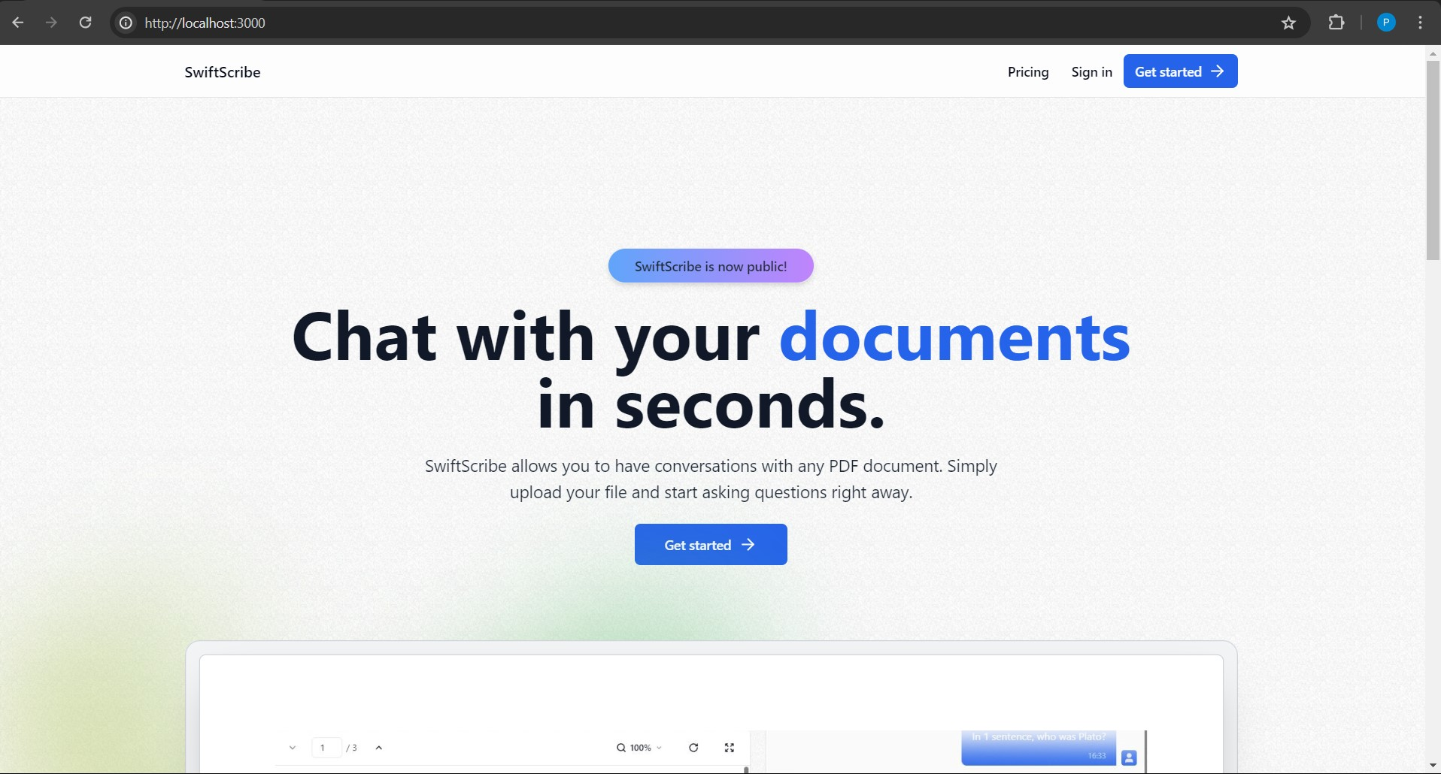
Output:

Slide 14
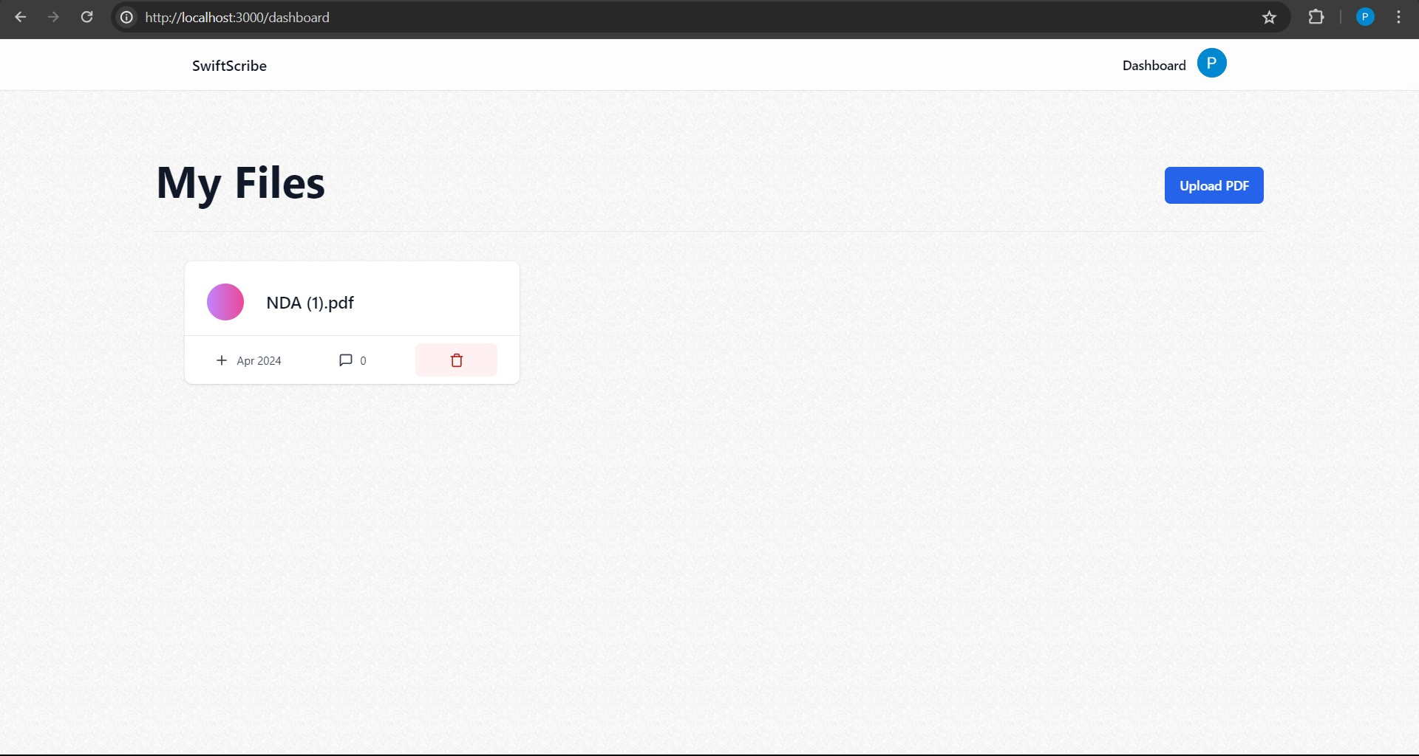
Output:

Slide 15
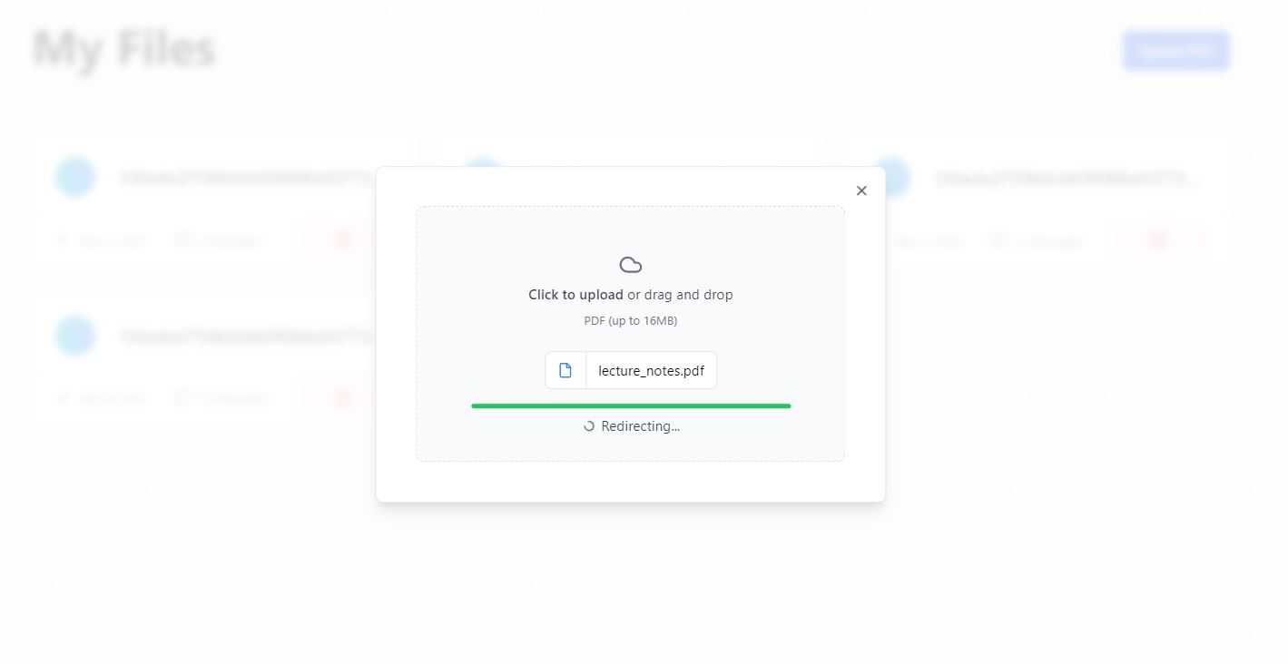
Output:

Slide 16
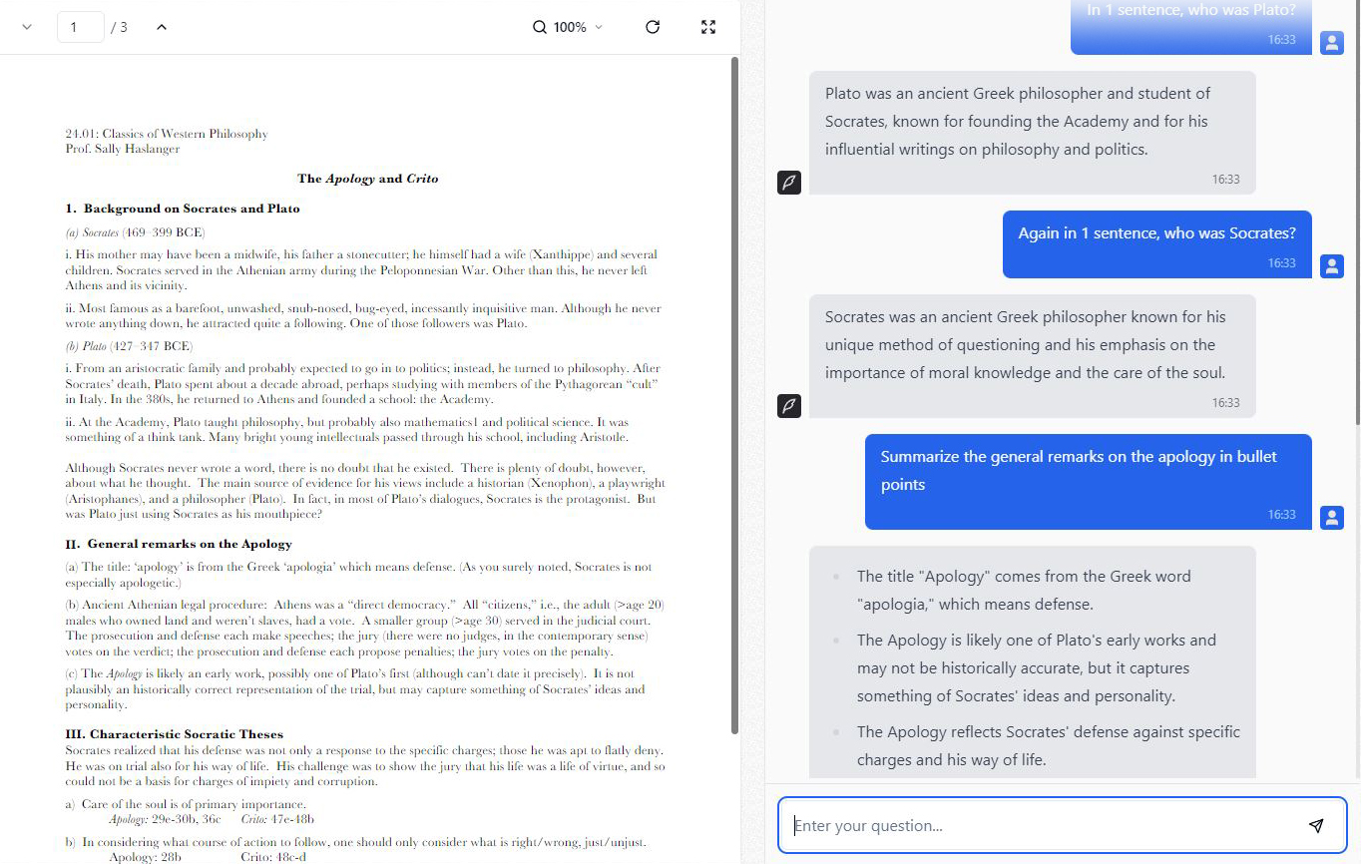
Output:

Slide 17
Conclusion:
The platform utilizes AI for real-time PDF summarization, answering queries . PDFs become searchable upon upload, eliminating manual scanning. Users can upload multiple files with free plan limitations. It boasts a user-friendly interface, secure authentication, responsive design, and cost-effective free and paid plans.

Slide 18

Thank You
We appreciate your time and attention during this presentation. Thank you for considering our PDF SaaS platform as a solution for your document sumarization needs.

